Slide 1
Bachelor degree in
Sustainable Business for Societal Challenges
Induction days – September 11-12, 2023

Slide 3
Notes:
A business administration degree that aims to be…

Slide 4
Notes:
…that aims to be innovative

Slide 5
Notes:
In the subjects

Slide 6
Notes:
But also in the teaching proposal…

Slide 7
Notes:
You have to take your part….What we want from you

Slide 8
You are requested to: START FROM THE BEGINNING
Notes:
You are expected to start classes from the beginning.
If you start later on, you will have a gap that is difficult to fill.

Slide 9
You won’t receive your ID card until you complete your enrolment procedure (VISA is required)
Remote attendance is not provided
Contact professors when you start attending classes

Slide 10
You are requested to: ATTEND ALL CLASSES
Notes:
Learning starts during classes. You are expected to have a proactive approach, to actively take part in classes.

Slide 11
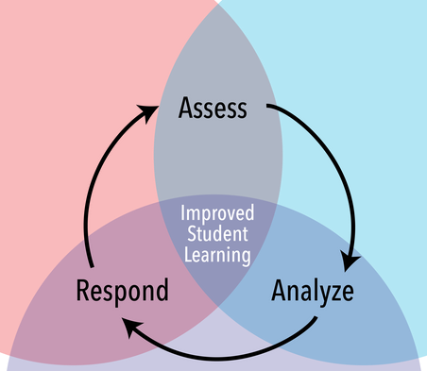
ONGOING EVALUATION CYCLE

Slide 12
You are requested to: DO YOUR HOMEWORK
Notes:
encurage

Slide 13
You are requested to: TAKE PART IN TEAM PROJECTS

Slide 14
You are requested to: TAKE PART IN INTERMIDIATE TESTS

Slide 15
Notes:
It a really demanding proposal. I want to be clear. You will have to work hard during the terms…however

Slide 16
Notes:
…our slogan is…

Slide 17
Notes:
The final exam is all downhill.
If you have done your works during the term the final exam is just a formality. In could cases, you mighth register the mark obtained from the ongoing evaluation.

Slide 18
 | Team work | Home work | Int | Final | Attend
Accounting and reporting | 20% | 5% | 50% | Written (25%) | Up to 2 additional point
Analytic tools for social change | 0% | 20% | 40% | Oral (30%) | 10%
Economy and society |  | 10-25% | 10-25% | Written (40-70%) | 5-15%
Introduction to private law | 25% | 20% | 50% | Oral (5%) | -
Grade policy (first semester)

Slide 19
 | First | Second | Third | Forth | Fifth
Accounting and reporting | 09/10 | 06/11
Analytic tools for social change | 11/10 | 27/10 | 15/11 | 29/11 | 06/12
Economy and society
Introduction to private law | 02/10 | 17/11 | 4/12
Intermediate schedule

Slide 20
Notes:
A lot of time to spend on holiday….
Well deversed rest

Slide 21
Notes:
…or arguably on

Slide 23
https://www.cisiaonline.it/area-tematica-english-tolc-economia/home-english-tolc-e/

Slide 24
YOU CAN’T TAKE EXAMS IF YOU DO NOT TAKE THE TEST BEFORE

Slide 25
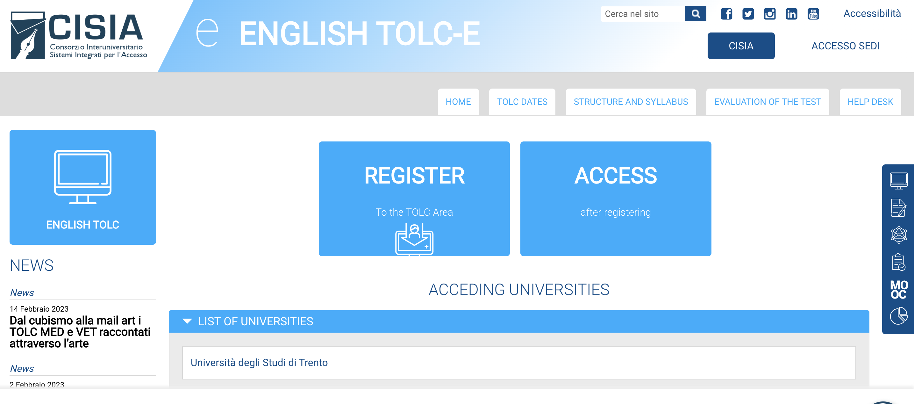

Slide 26
Can I register for final exams?
I FAILED THE TEST
YES
OFA online suppletive courses to attend in your FIRST YEAR

Slide 27
B2

Slide 28
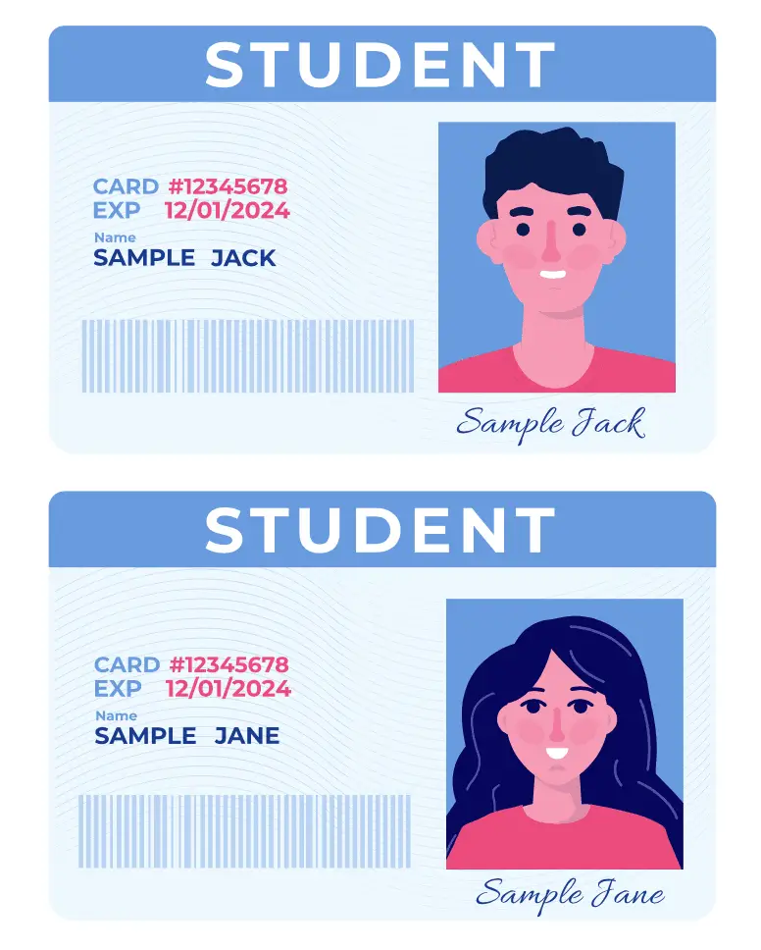

Slide 29
https://e-l.unifi.it/

Slide 31
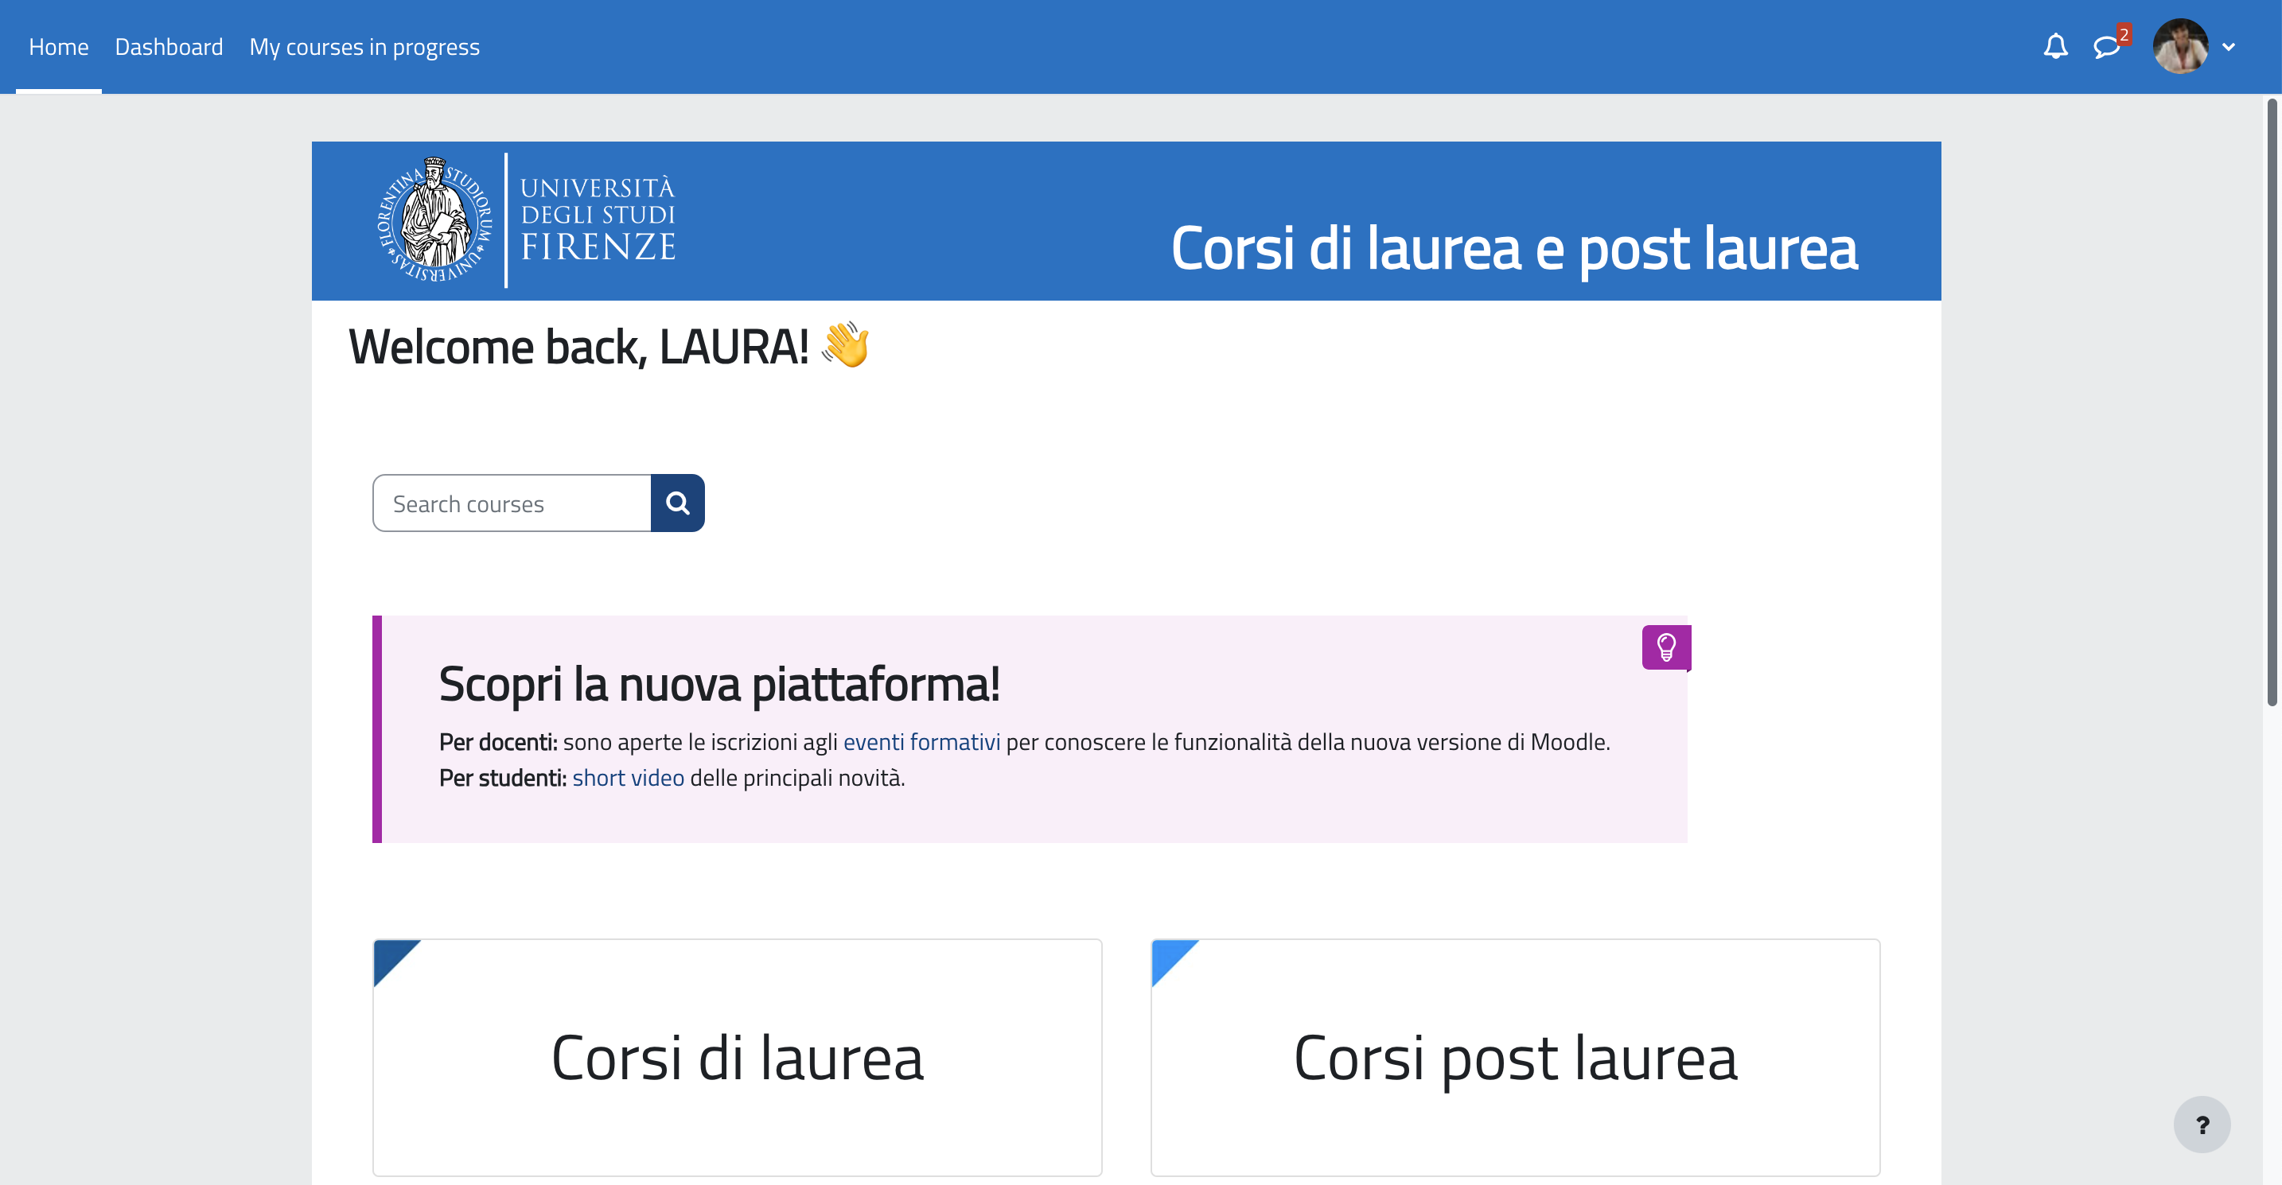
B031705 (B247) - ACCOUNTING AND REPORTING FOR BUSINESS AND SUSTAINABILITY 2023-2024

Slide 33
name.surname@unifi.it

Slide 34
Laura Bini
Via delle Pandette, 9
50127 – Firenze
Building D6 room 3.44
l.bini@unifi.it

Slide 35
STUDY PLAN information
ERASMUS calls
EUNIWELL initiatives
TRAINERSHIPS
SEMINARS
…

Slide 37
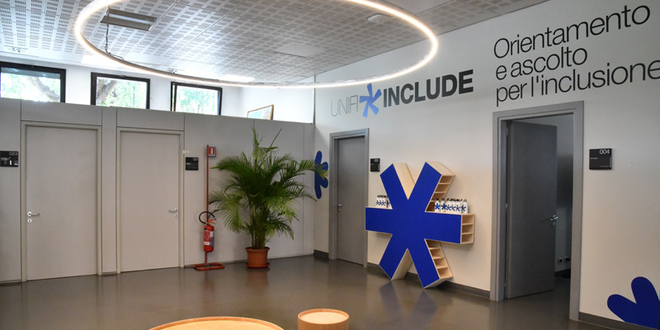
https://www.unifi.it/changelang-eng.html

Slide 39
I cannot partecipate in presence because of my work (at least for now), how is the quality of the course for people who cannot attend classes in person?
If I'm working I should go for the courses every day or i can study it from home ?
Course attendance is strongly recommended for this course. You must contact professors to ask them how to manage this issue
will the classes be at the same time every week or might they change week by week?
The course schedule is defined in advance
https://kairos.unifi.it/lezioni/Riservato/Scuola_di_Economia_e_Management/2023-2024/329/index.html
Teachers will inform about any necessary change

Slide 40
É possibile partecipare alle lezioni se ancora non è stata compilata la domanda di immatricolazione? Se si, è necessario comprare i libri per studiare o sono sufficienti gli appunti e le schede caricate online? (Can I attend the courses even if I am not enroled?)
You need a student ID to be allowed to attend courses
Is there an online platform to access attended lecture videos/ sides and other resources? If so how do you access them
https://e-l.unifi.it/
Login (student ID and Password) required

Slide 41
When does the application process start for international student September 2024 intake?
Enrolment deadline: November 8
Erasmus exchange program: usually on January
Stationery required for the course?
Laptop and calculators may be useful
I'm interested in obtaining additional information regarding the CLA English test for prospective students to the Economics in Sustainable Business for Societal Challenges program. Is it acceptable as an alternative to the English Proficiency test, such as IELTS?
Only for EU citizen an it must be take in presence only
Notes:
Stationery required for the course?

